Slide 1
Running Manual BPT Tests
Elaborated by: Douglas Garcia
douglas@ideliver-inc.com

Slide 2
Agenda
How to run manual tests from HP ALM
How to run manual tests from HP Sprinter
Demo
Exercise

Slide 3
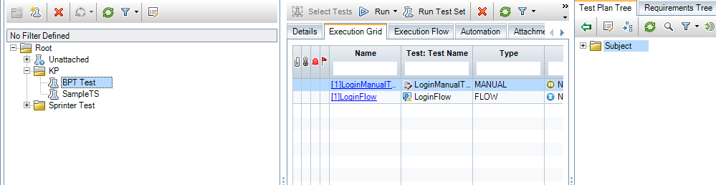
How to Run a BPT Test Manually From the Test Lab
Create a test set in the test lab module
Select a test
Click “Quick Add” to add the test into the execution grid
2
3
1

Slide 4
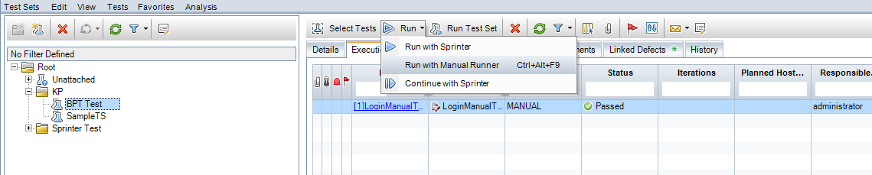
How to Run a BPT Test Manually from the Test Lab
Click “Run”
Select “Continue Manual Run”

Slide 5
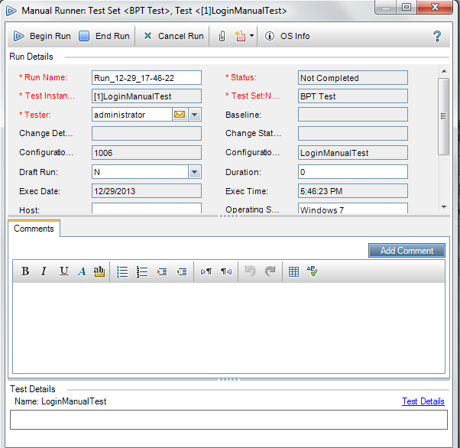
Running a BPT Test Manually From the Test Lab(Cont.)
Click “Begin” To run the Test

Slide 6
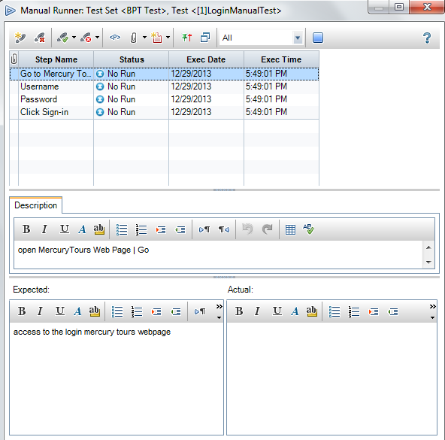
Running a BPT Test Manually From the Test Lab(Cont.)
Add/Delete New or existing steps
Pass/Fail selected pass
Stop Run
3
1
2

Slide 7
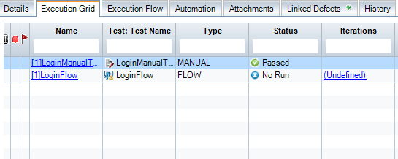
Running a BPT Test Manually From the Test Lab(Cont.)
If the test passed/failed or it was not totally completed, the status of the test from the execution grid will be updated as soon as the run ends.

Slide 8
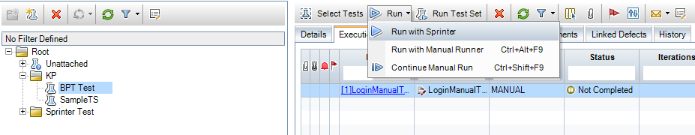
Run a BPT Test From Test Lab with Sprinter
From Test Lab, select “Run with Sprinter”

Slide 9
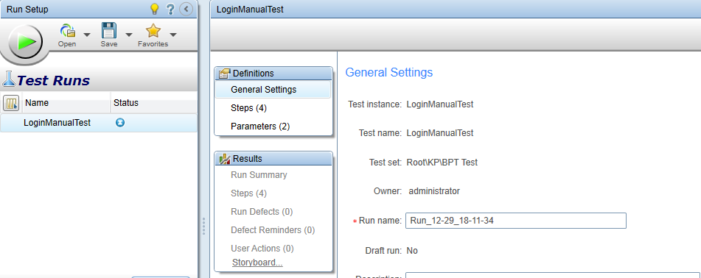
Run a BP Test from Test Lab with Sprinter(cont.)
Click “Run the Activate test”

Slide 10
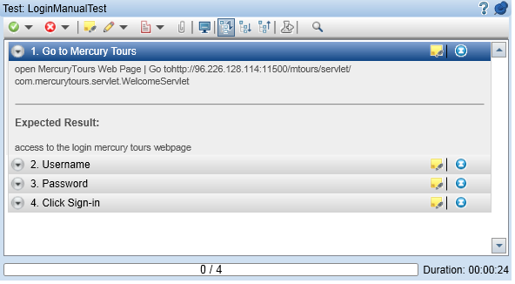

Run a BP Test From Test Lab with Sprinter(cont.)
STOP
Add/delete a new step

Slide 11

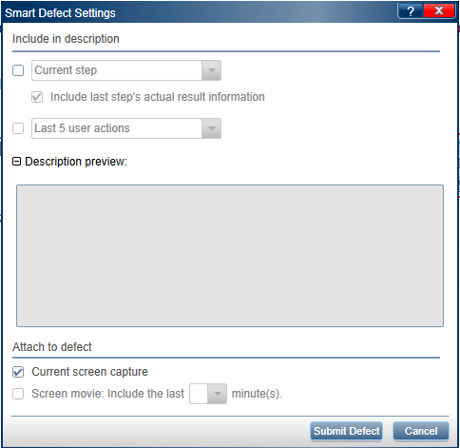
Submitting Defects From Sprinter
1
While executing a test, go to the tools sidebar
Click “Smart Defect”
Click “Submit Defect”
2
3

Slide 12
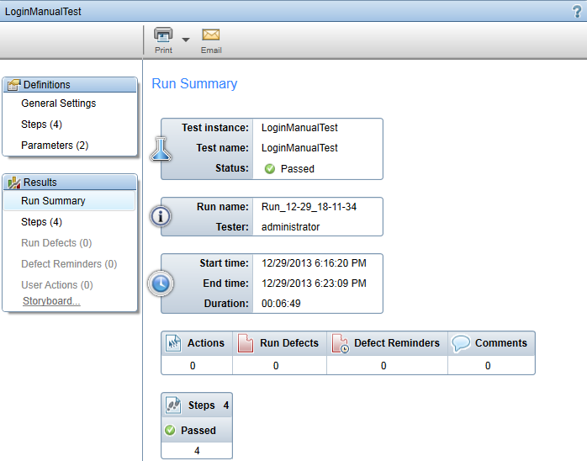
Test Run Summary From Sprinter

Slide 13
Run a Business Component From Sprinter
Create a test set in the test lab module
Select a test
Click “Quick Add” to add the test into the execution grid
2
3
1

Slide 14
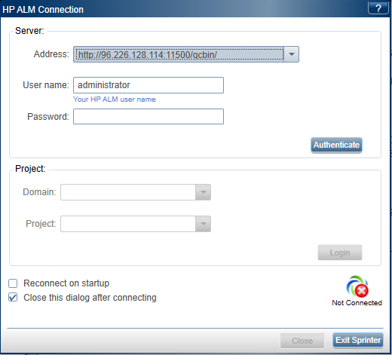
Run a Business Component From Sprinter(Cont.)
Log into ALM server
Click “Authenticate”
Select a domain
Select a project
Click “Login”
1
2
3
4
5

Slide 15
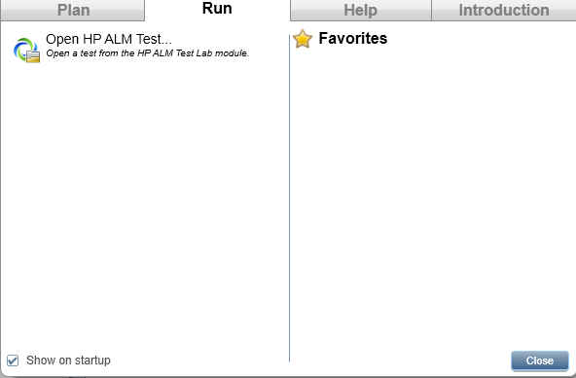
Run a Business Component From Sprinter(Cont.)
Go to the Run Tab
Select “Open HP ALM test”
1
2

Slide 16
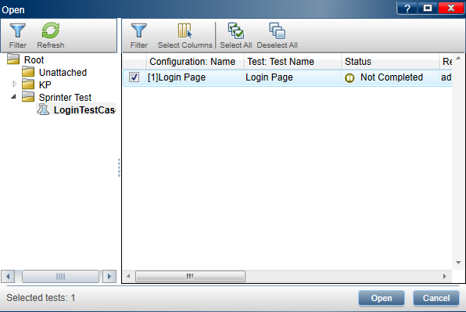
Run a Business Component From Sprinter(Cont.)
Select the test
Click “Open”
1
2

Slide 17
Run a Business Component From Sprinter(Cont.)
Click “Run the Activate test”

Slide 18


Slide 19

Exercise

